Slide 1
Afghan Network Requirements
ANSF Network, ANSFN (Unsecure)
Afghan National Command Authority Network, ANCAN (Secure)

Slide 2
ANSF Network, ANSFN (Unsecure)
Physically connects MoI, MoD, and Presidential Campus.
Does not consolidate logical domains
Infrastructure exists (ISP) to support
Internet access
Not secure
Voice, video, and data sharing capable
Currently capable of reaching Regional HQs

Slide 3
Afghan National Command Authority Network, ANCAN (Secure)
Physically connects NDS, MoI, MoD and Presidential Campus networks via hard spliced fiber
Single logical domain capable
No current infrastructure exists (ISP) to support
No Internet access
Secure voice, video, and data sharing capable
Not currently capable of reaching Regional HQs

Slide 4
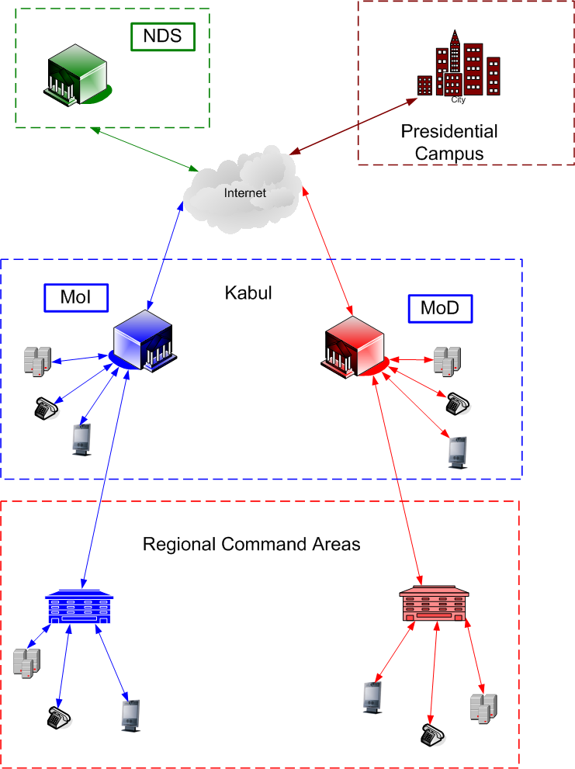
Current MoI – MoD – PSR - NDS Connectivity

Slide 5
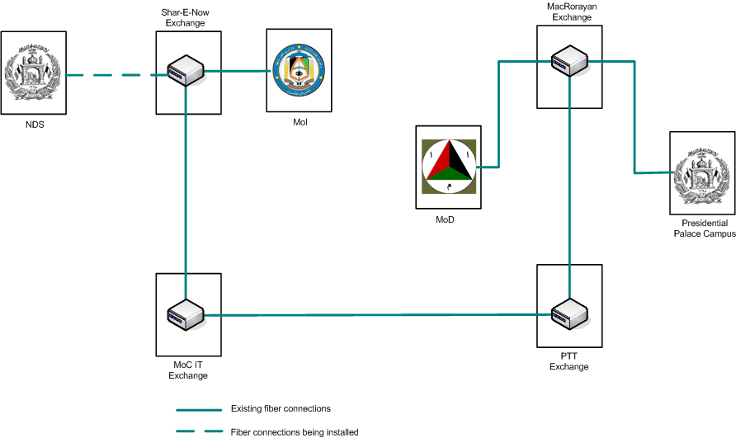
NDS PSR, MoI, and MoD Physical Connectivity

Slide 6
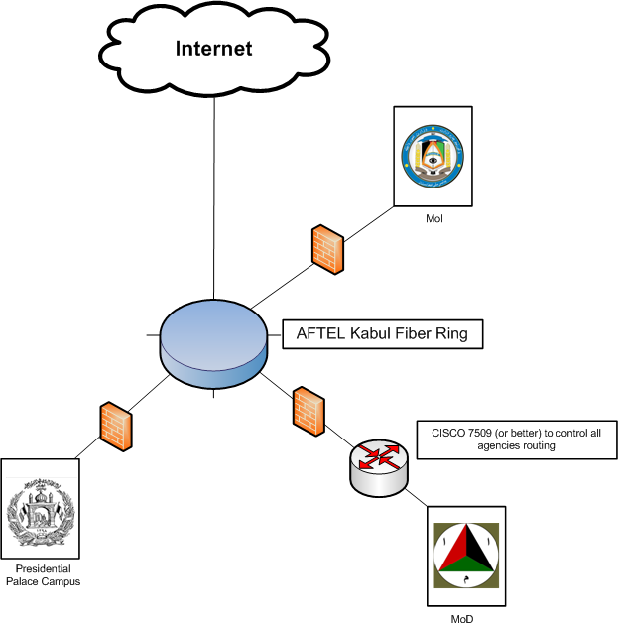
ANSF Network, ANSFN (Unsecure) PSR, MoI, and MoD Connectivity

Slide 7
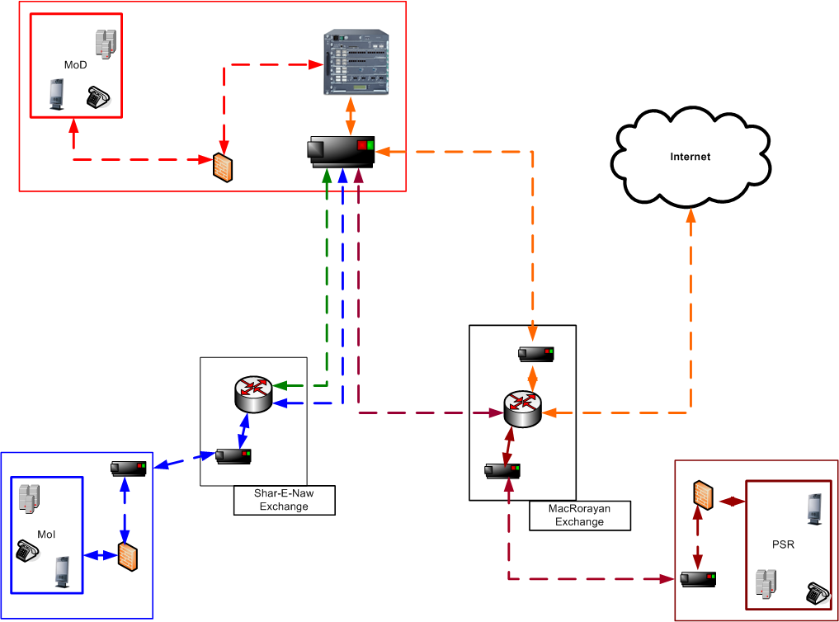
ANSF Network, ANSFN (Unsecure) PSR, MoI, and MoD Connectivity
All MoI, and PSR external network traffic routed through AFTEL Fiber Ring to ANSF Core Router in MoD NOC.
All ANSF network Internet traffic routed through ANSF Core router and back through AFTEL Fiber Ring

Slide 8
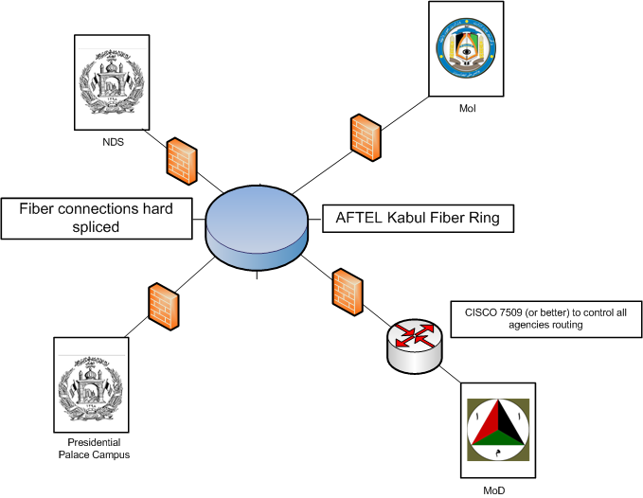
Afghan National Command Authority Network, ANCAN (Secure) PSR, NDS, MoI, and MoD Connectivity

Slide 9
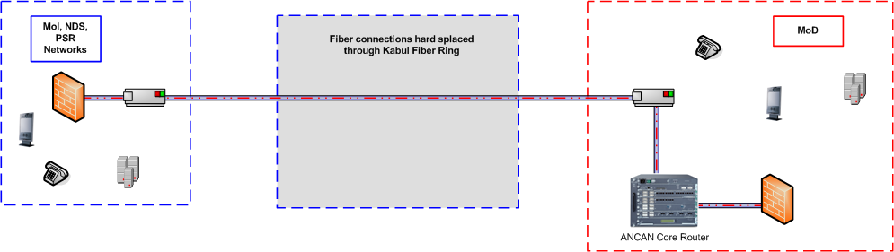
Afghan National Command Authority Network, ANCAN (Secure) PSR, NDS, MoI, and MoD Connectivity
All Afghan National Command Authority Network traffic routed through ANAN Core Router in MoD NOC.

